Slide 1

mXpress
Bi-Weekly Scrum #1
By Team MX
Ranil Fernando, Scott Thomas, Jonathon Florek
2019-10-11

Slide 2

mXpress Emergency Vehicle Routing System
Solving slow emergency response times in large cities
Fills the need for high quality, specialized routing systems for emergency dispatchers
Innovates by utilizing both batch and stream big data coupled with AI to do predictive and reactive trip planning
Potentially allows for consumer vehicle routing using batch data
Adaptable framework allows for multiple qualities of service provided
Notes:
Similar technologies exist, often lacking real time telemetry
Improve emergency service response times in major cities
Yes, technologies exist (public like google maps) and other research projects exist using similar data
Average road speed telemetry
Municipalities/ emergency response/ 911 dispatch
Technology can only be applied in cities with sensors/date collection to provide enough telemetry (toronto)
Discuss from your team’s
Project vision
Project rationale
Envisioned stakeholders
Assumptions and envisioned constraints

Slide 3

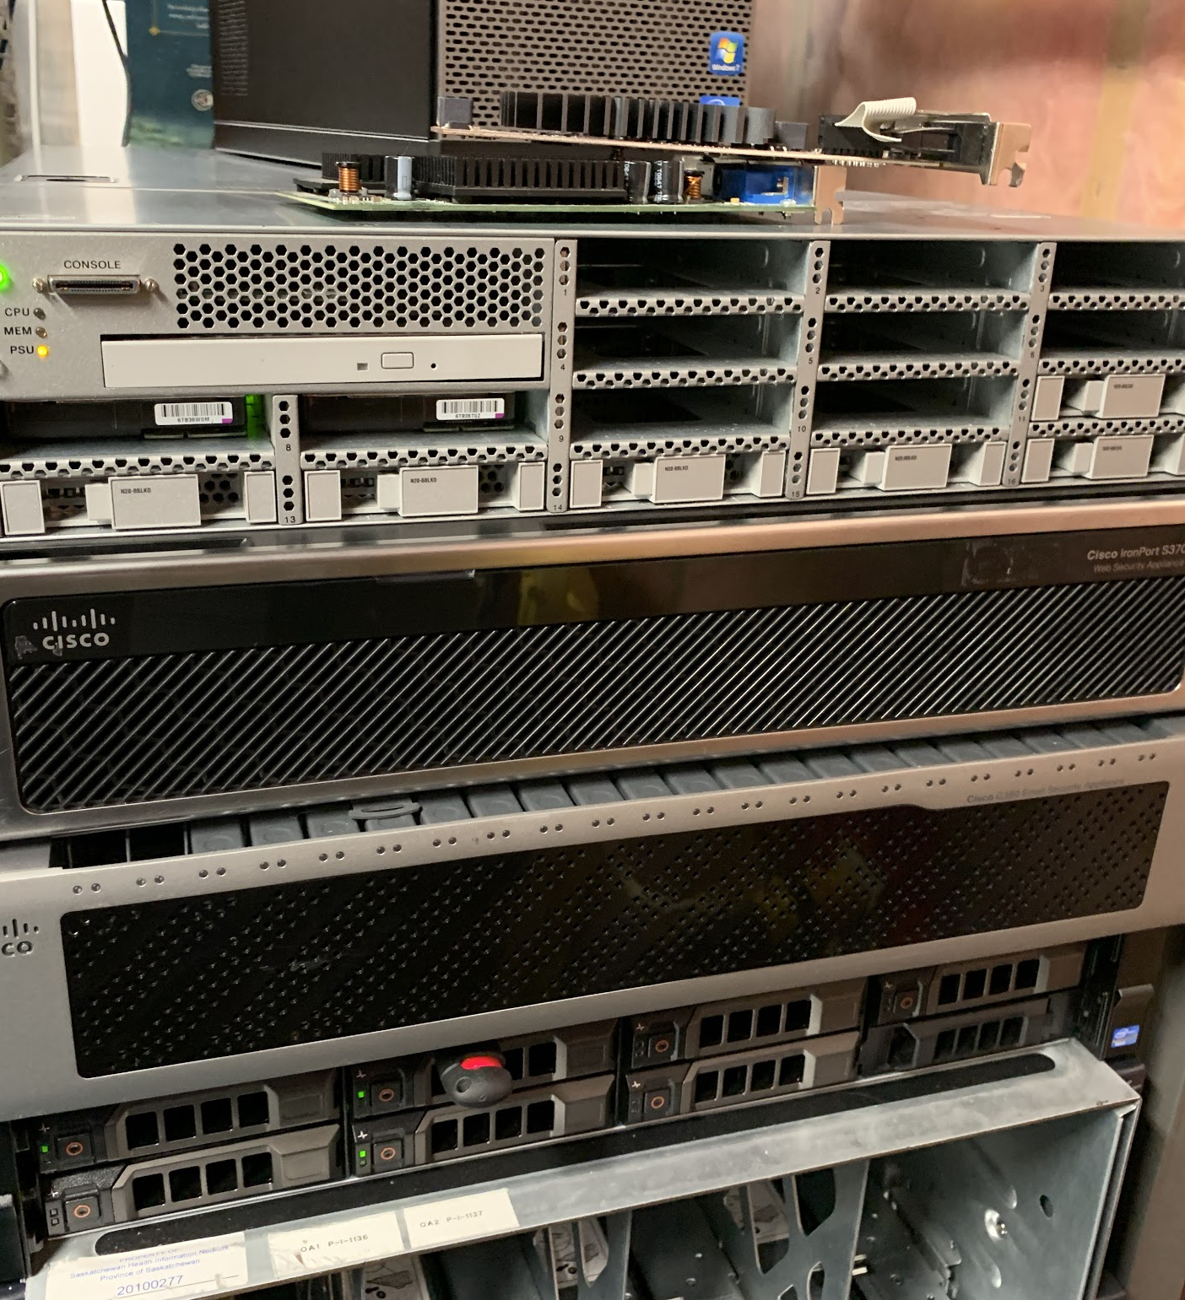
Current Work in Progress
Requirements
Framework should be adaptable to encompass other big data problems, not just vehicle routing
Should have low latency
Should be scalable
Testing Backbone
Will allow for evaluation and testing of Spark + other Apache systems
Open Trip Planner Evaluation
Simple to extend
Hooks directly into OSM
Has empty functions for traffic speed
Testing Plan
TBD
Notes:
Similar technologies exist, often lacking real time telemetry
Improve emergency service response times in major cities
Yes, technologies exist (public like google maps) and other research projects exist using similar data
Average road speed telemetry
Municipalities/ emergency response/ 911 dispatch
Technology can only be applied in cities with sensors/date collection to provide enough telemetry (toronto)
Discuss from your team’s
Project vision
Project rationale
Envisioned stakeholders
Assumptions and envisioned constraints

Slide 4
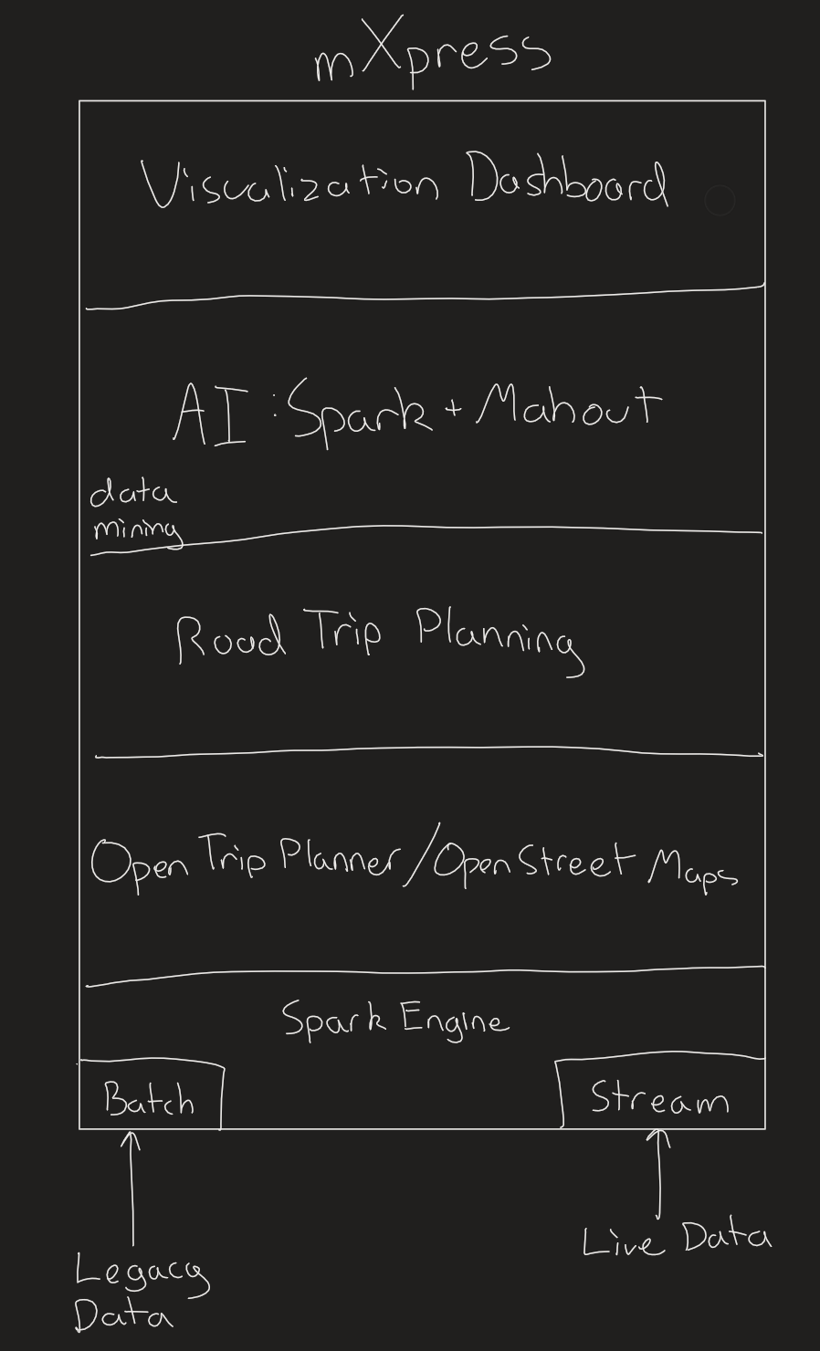
mXpress Architecture
Visualization Dashboard
Performance Metrics
Data Visualization
AI
Data Mining
Predictive Analysis
Capabilities provided by Apache Spark & Mahout
Road Trip Planning
Extension to OTP and OSM to provide vehicle routing
OTP/OSM
Engine to handle and develop vehicle routing and mapping services
Spark Engine
Handles Big Data
Batch (Old data for predictive analysis)
Stream (Live data for up to date traffic analysis)
Notes:
Similar technologies exist, often lacking real time telemetry
Improve emergency service response times in major cities
Yes, technologies exist (public like google maps) and other research projects exist using similar data
Average road speed telemetry
Municipalities/ emergency response/ 911 dispatch
Technology can only be applied in cities with sensors/date collection to provide enough telemetry (toronto)
Discuss from your team’s
Project vision
Project rationale
Envisioned stakeholders
Assumptions and envisioned constraints

Slide 5
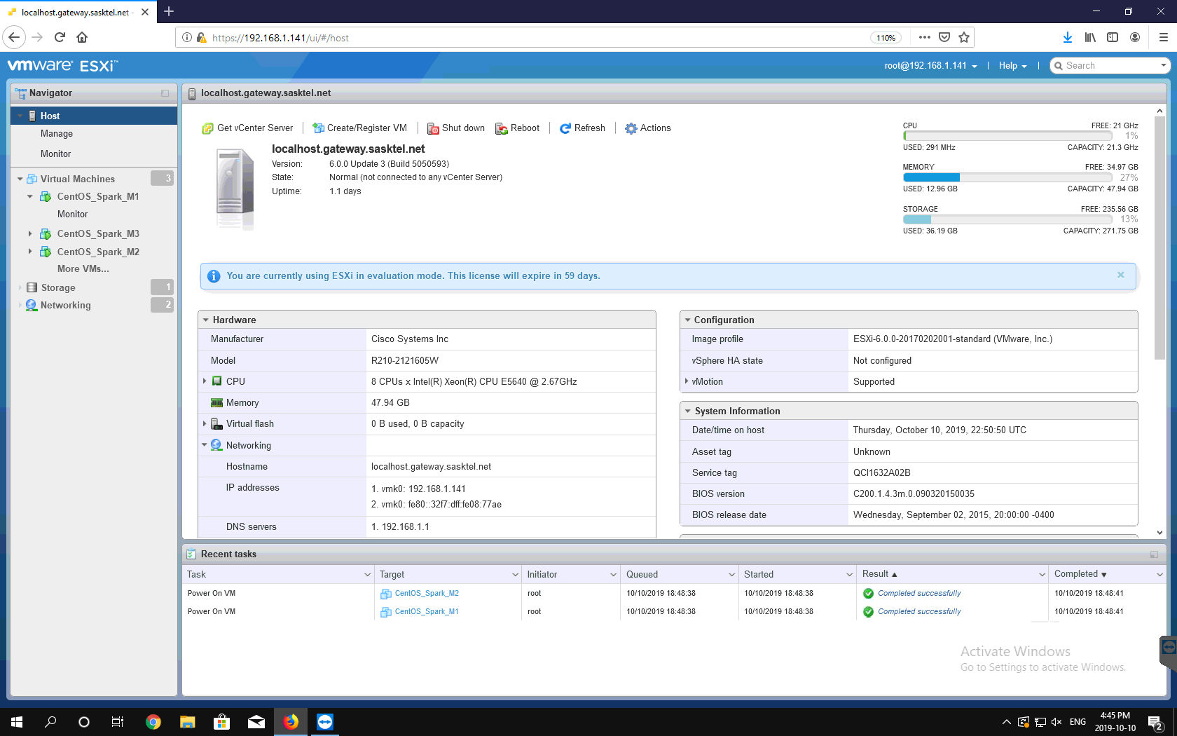
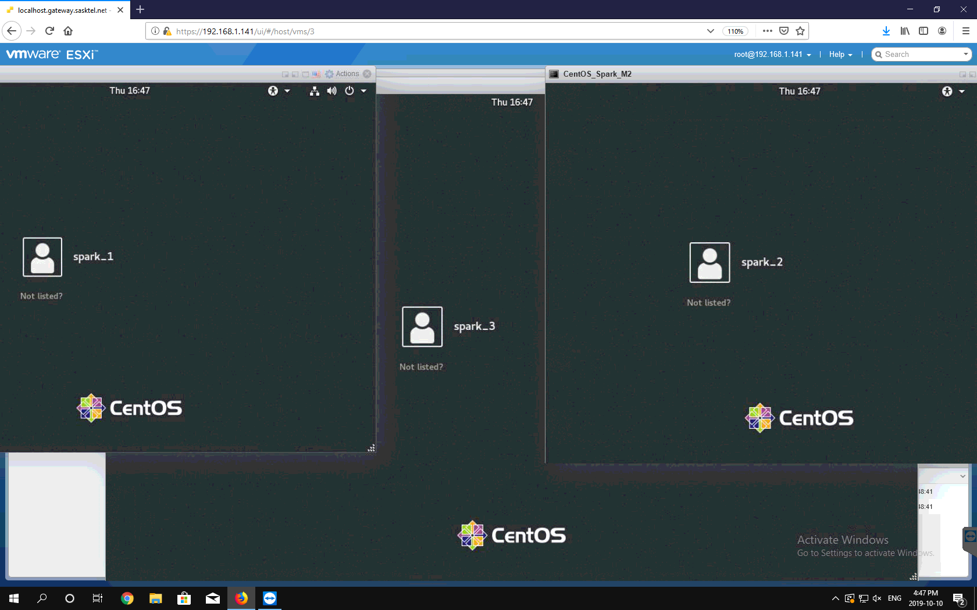
Backbone
Cisco UCS C210 M2 w/VMware ESXi
3 CentOS 8 VMs
16GB of RAM per node
5 VCores per node
80GB of Storage per node
Used for testing sandbox only - to be replaced soon

Slide 6

Group Reflection
Do you feel you are on track?
Yes, the main priority is getting the backend setup so the big data components can be tested. This is almost complete.
Do you feel there are barriers to your success (if any)?
Lack of documentation
Enterprise grade hardware requirements
Do you need any help going forward?
Potentially a better server hosting site.
Any other questions or concerns?
Nope
Notes:
Similar technologies exist, often lacking real time telemetry
Improve emergency service response times in major cities
Yes, technologies exist (public like google maps) and other research projects exist using similar data
Average road speed telemetry
Municipalities/ emergency response/ 911 dispatch
Technology can only be applied in cities with sensors/date collection to provide enough telemetry (toronto)
Discuss from your team’s
Project vision
Project rationale
Envisioned stakeholders
Assumptions and envisioned constraints

